Slide 1
CS2030 Lab 3
AY22/23 Sem 2

Slide 2
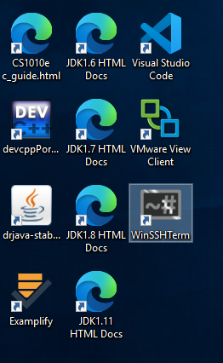
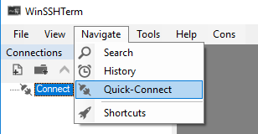
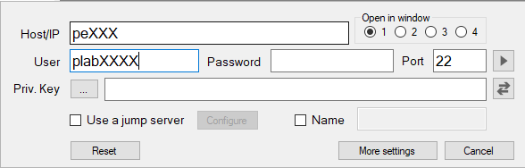
Admin Matters
Please log in to the PE node first!

Slide 3
GitHub Handle
Please provide your GitHub handle (username) to in the form below so that we can track your contributions :)
Form: https://forms.gle/NYjH6c8wfGjhYs4U9
Contributions in terms of:
Asking Questions on GitHub Issues
Answering Questions on GitHub Issues
Contributing to GitHub Wiki (sharing CS2030 related materials)
These will be taken into account under class participations and learning activities

Slide 4
Compile Time Type vs Run Time Type
Compile-Time Type
Run-Time Type
Left hand side of the assignment, fixed upon declaration
Static Binding
Restrict methods that can be called based on compile time type
Right hand side of the assignment, varies as the program runs
Dynamic Binding
Controls the type of methods that can be called during runtime.

Slide 5
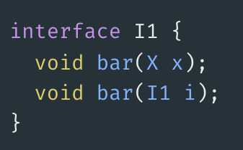
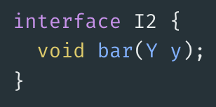
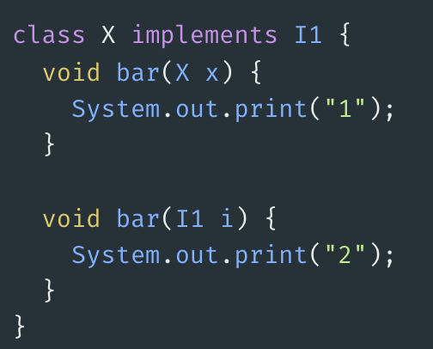
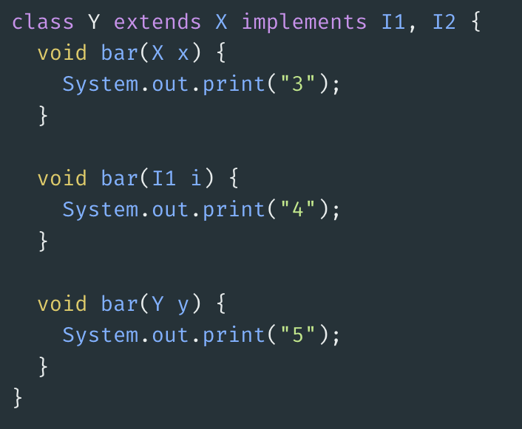

Slide 6
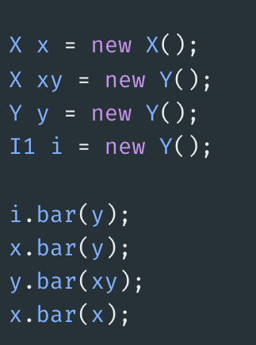

Slide 7
Why Polymorphism?
Hide implementation details by interacting with a group of different classes through a common interface
Ability to extend program requirements without changing much code (loose coupling between different components)

Slide 8
Lessons from Lab 02
Use polymorphism to hide implementation details away from Simulator
Do not need to invoke different logic by checking for event type
Polymorphism allows for extendability for new event types

Slide 9
New Restrictions on CodeCrunch
The following are banned on CodeCrunch:
Any attempts to typecast
Any attempts to check the type of the instance
Enums
Avoid type checking because it defeats the purpose of polymorphism

Slide 10
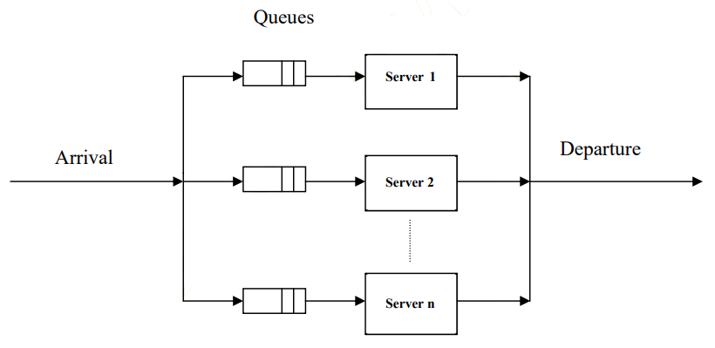
Lab 3
In this lab, we introduce queue to each server, and another new WAIT event, such that if all servers are serving customers, then the customer that just arrived scans the queues of the servers and join the first queue that is not full (not necessarily the shortest) and waits in the queue (WAIT event).

Slide 11
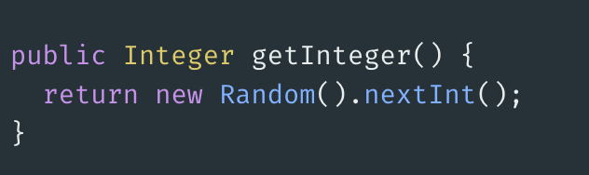
Supplier (Supplier<T>)
A supplier is a functional interface
It takes in no arguments and returns a result
E.g:

